Slide 1
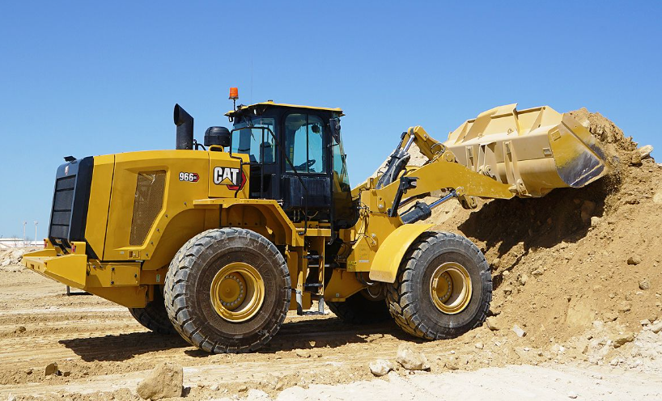
CAT 966GC wheel loader
CAT 966 GC

Slide 2
966GC - BASIC, TOUGH and AFFORDABLE Multi-purpose loader
Key design criteria
Simple to operate, maintain and service ‘All I Need’ features
Cat world-class reliability Caterpillar designs and components
Low fuel consumption Load sense hydraulics and fully CAT designed system integration
Performance to get the job done Performance series buckets
Lower acquisition costs

Slide 3
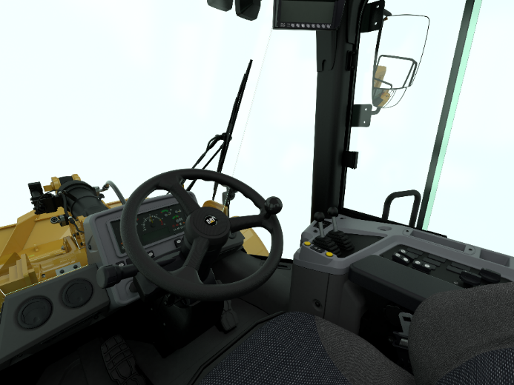
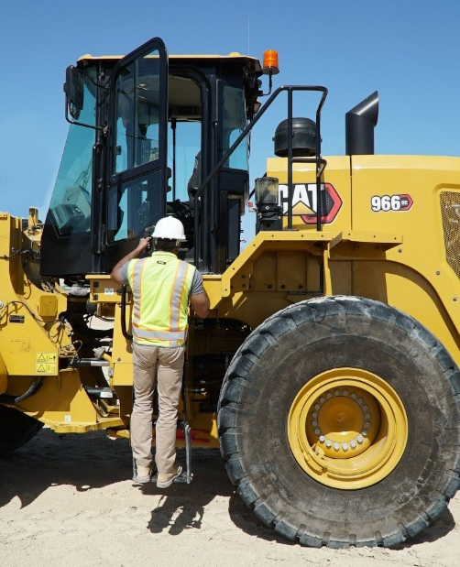
Simple to operate
If operator knows how to use wheel loader – he will quickly get used to this one
Easy to operate, intuitive controls and simple user interface
Pilot-operated hydraulic implement controls deliver low-effort operation
Extended side windows with wide, flat front windshield for better visibility
Ladders on both sides for easy access

Slide 4
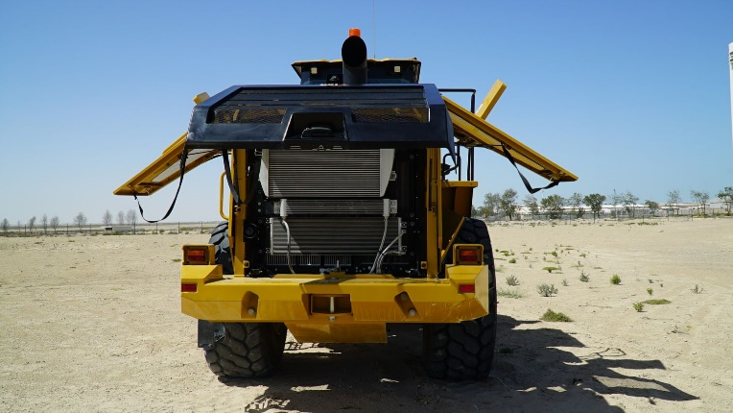
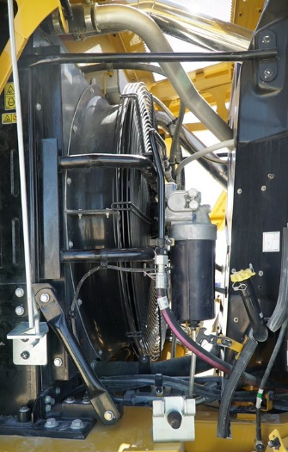
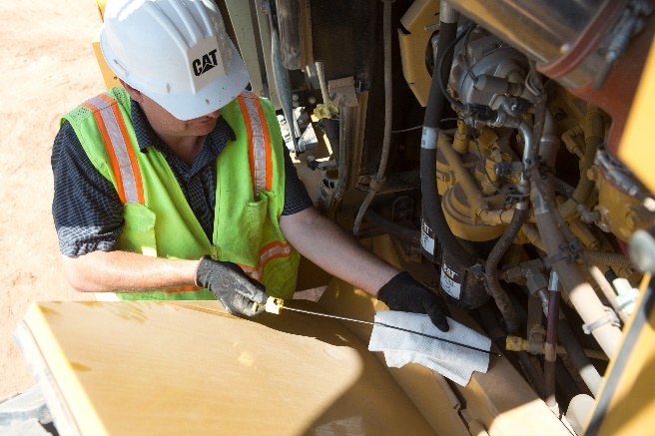
Simple to maintain and service
Easy to maintain and service
Low fuel consumption with on-demand fan and load-sensing hydraulics
Convenient service points and sight gauges allow for quick daily maintenance

Slide 5
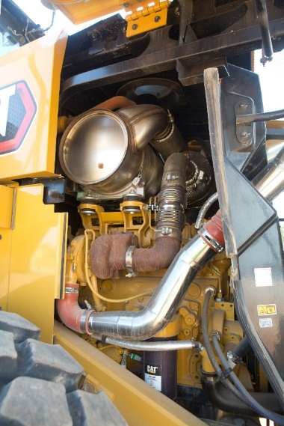
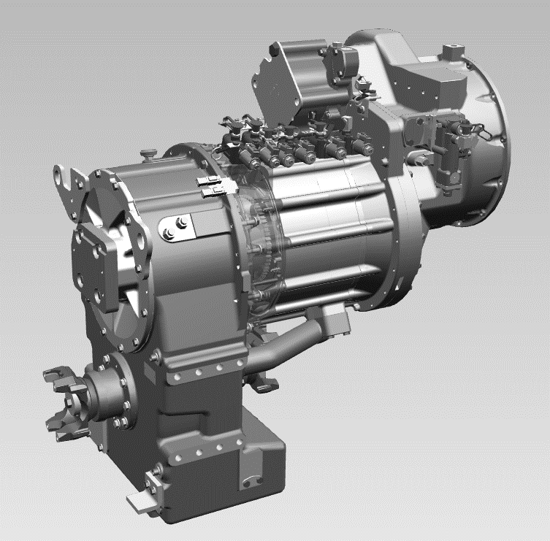
Short downtimes because it requires very little maintenance
Low consumption thanks to the CAT engine technology
Integrated Cat machine systems result in lower fuel consumption
Engine
Low consumption, reliable CAT 6 cylinder diesel engine C9.3B
Latest engine technology meets Stage V
Cat passive regeneration - simple, reliable and service free solution invisible to the operator
Non-EGR air system for improved reliability
Transmission
Caterpillar designed Planetary type
Smooth and efficient machine operation
Durability – derived from 966H

Slide 6
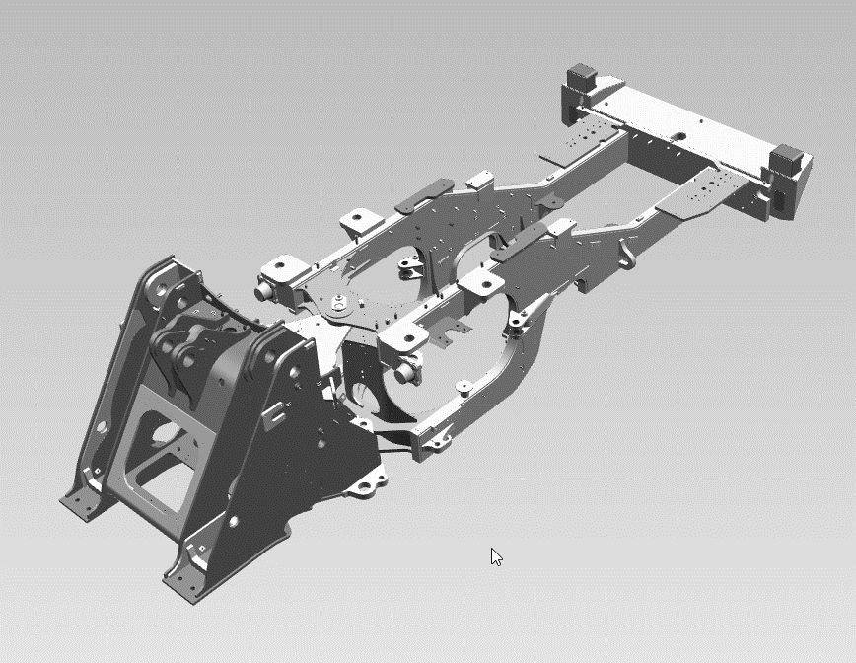
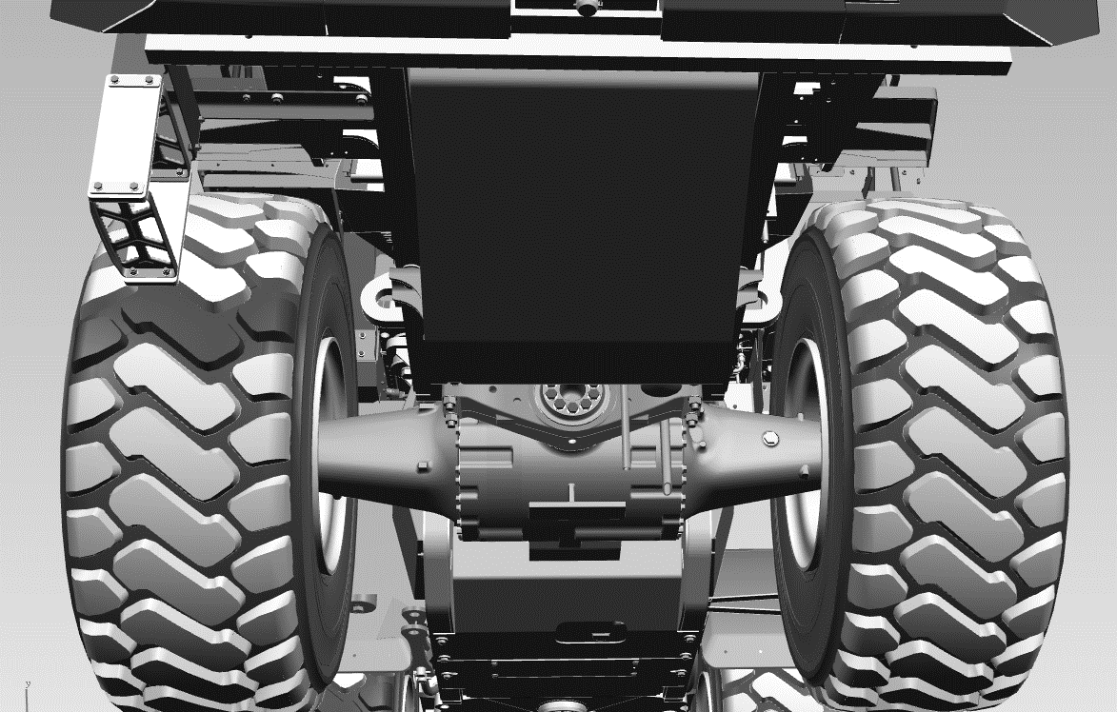
Reduce downtime with maximum DURABILITY
Durable and reliable chassis, axles, Z-bar linkage structures – design taken from 966 time tested series
Axles choices - Open Differentials F/R - LSD (R, F&R) (optional)

Slide 7
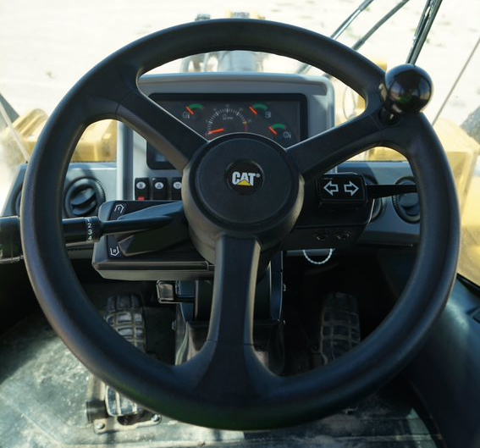
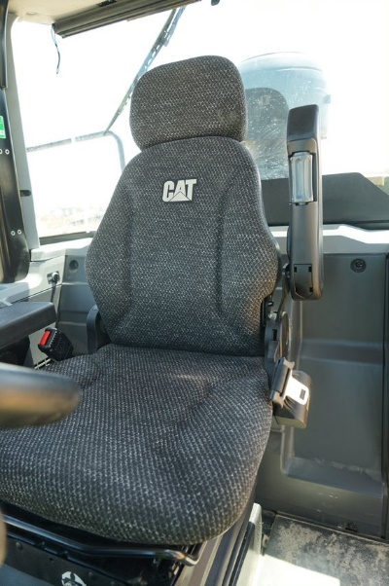
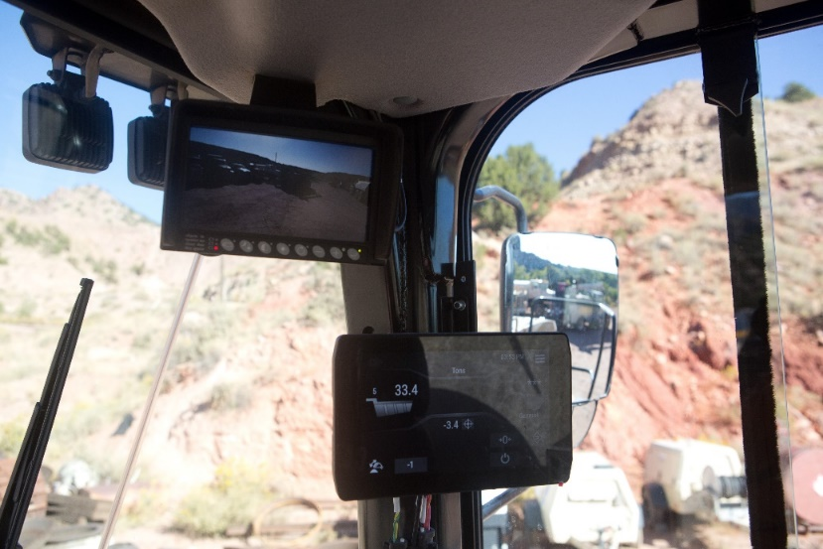
New common GC cab
Comfort and safety all day long
Welded ROPS structure
Air suspended seat
Pilot operated low effort implement control (levers or joystick)
CAT Payload (optional)
Air conditioner
Ride Control accumulator to reduce vibrations
Rear-view camera
Cat Payload Kit installation

Slide 8
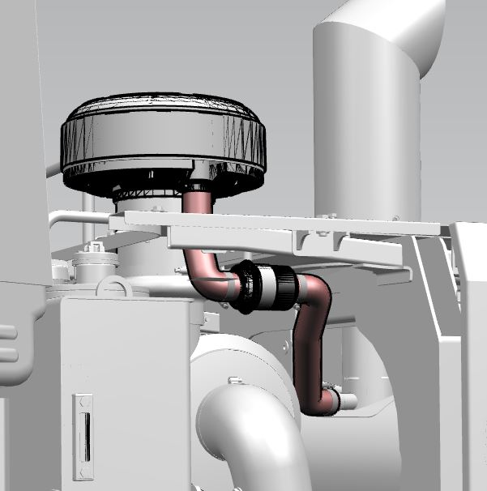
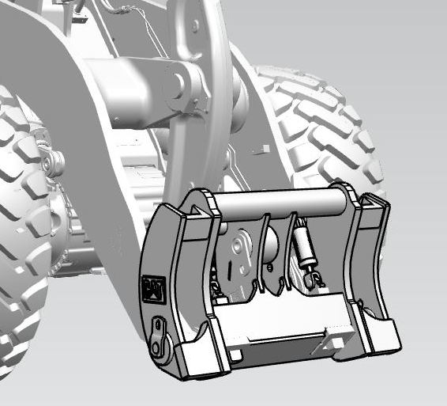
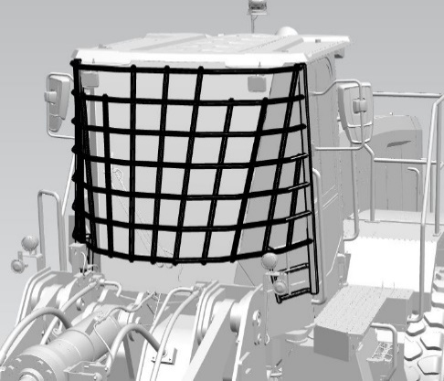
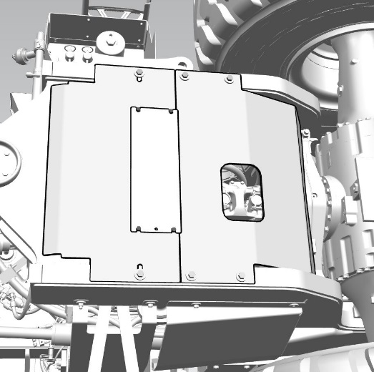
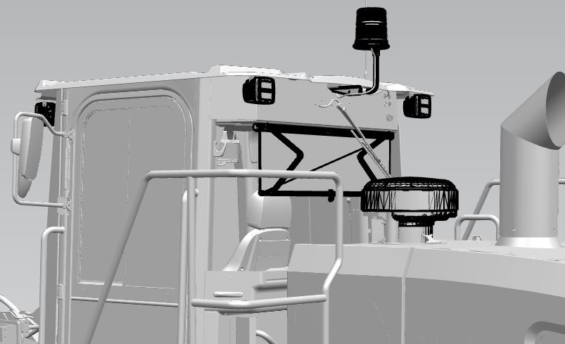
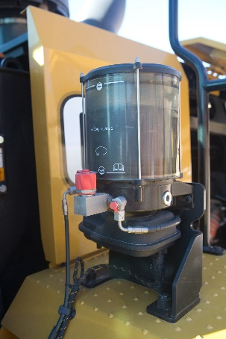
Use just one machine with machine VERSATILITY
Strata air pre-cleaner
Fusion quick coupler
Cat Autolube
Bottom guard
Beacon, Sunvisor, Scavenge pre-cleaner, LED lights
Cat Autolube

Slide 9
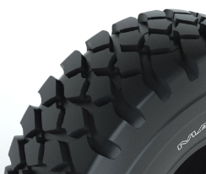
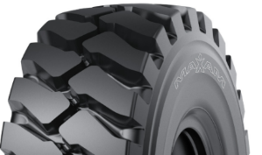
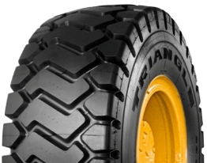
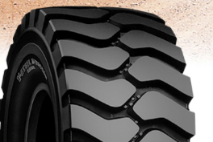
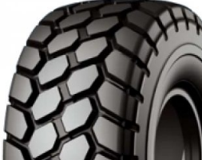
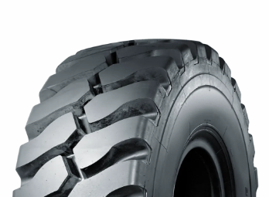
Tire offerings
L3 tire options fom factory
Maxam MS 302
Triangle TB516
Bridgestone VJT
L5 tire options from factory
Maxam MS 503
Bridgestone VSDT
Triangle TL538S+

Slide 10
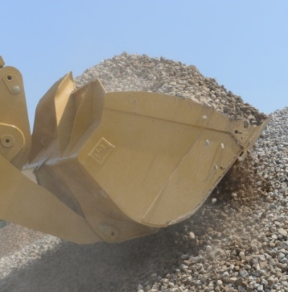
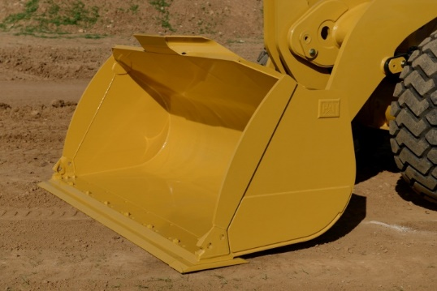
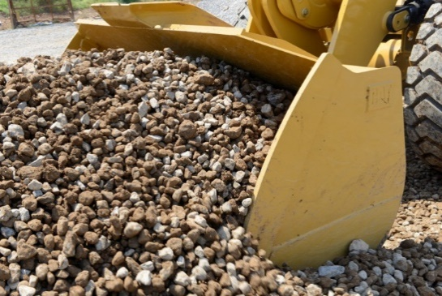
Maximum productivity through optimized tools
Cat Performance series buckets
Long floor, wide opening allows material to be loaded faster resulting in shorter cycle times
Rounded side walls, raised rear wall for better material retention therefore higher fill factor
Integrated spill guard protects linkage, hydraulics and cab components
Spill Guard
Curved Sidebar
Long Floor
Wide Opening

Slide 11
Visionlink – complete visibility for entire fleet
Maximize uptime
Monitor equipment health, fault codes, fluid analysis, and inspection due dates
Reduce unplanned downtime with critical alerts
Order parts and schedule service within the platform.
Optimize utilization
Manage according to projects, groups, or geofences
Set utilization targets and monitor performance
Make informed, data-based decisions to reduce operating costs.

Slide 12
CAT Financial financing solutions for best liquidity
Fixed service costs create clear conditions
Financial leasing:
Period from 12 to 60 months
Down payment: from 10%
Fixed interest rate
Payment schedule tailored to your needs and business specifics
Long-term rental:
Period from 12 to 60 months
Down payment: from 0%
Maintenance costs included in the fixed monthly payment
Option to buy back the equipment at the end of the rental contract
Financing of service products:
Allows you to purchase repairs, certified rebuild services or work tools on hire purchase
Term from 6 to 60 months
Down payment: from 0%
Fixed interest rate

Slide 13
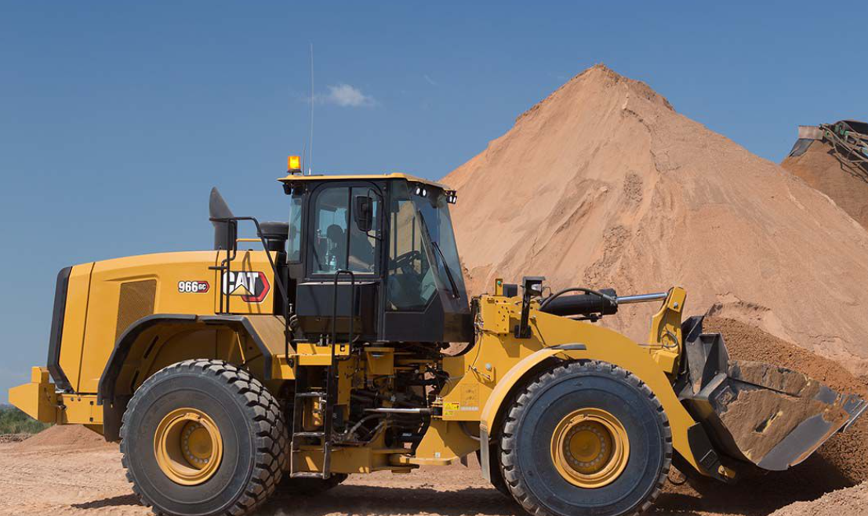
For more information please contact your local Avesco dealer

